Slide 1

Solar Responders
Alex Wernex, Ryan Hughes, Jay Sanders, Nicolas Santillan

Slide 2
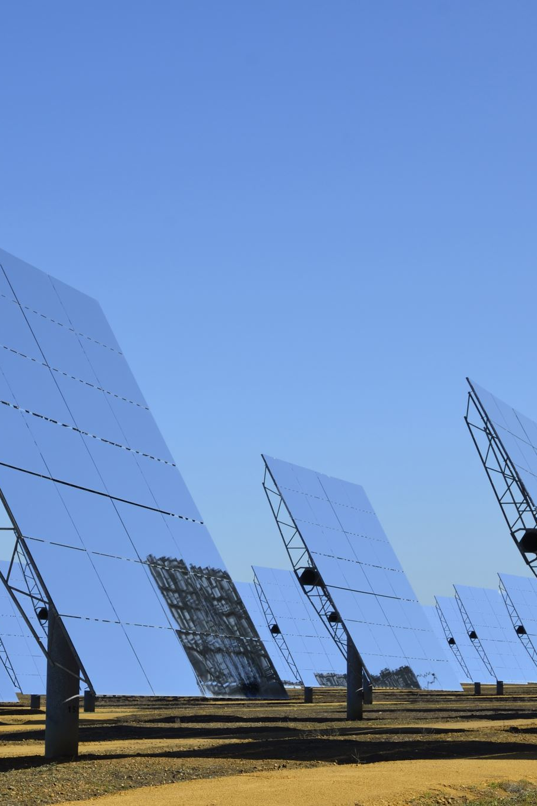
Overall Problem
Solar Panels on houses can cause different problems for firefighters on how to put out a house fire.
There is no standing global database that first responders or dispatchers have access to.
Depending on the area, many firefighters have no experience with fighting fires with solar panels involved.

Slide 3
Design Research
Our design research methods included a graffiti wall and interviews.
We ran into problems with the graffiti wall. Our post was taken down less than 24 hours after it was posted, but we received good feedback from one individual.
We interviewed 2 other individuals who lived in densely populated areas where solar panels were not something they ran into.
Firefighters do not have experience fighting fires with solar panels, and there is no centralized database. This means that firefighters have to rely on contractors who build the structures.

Slide 4
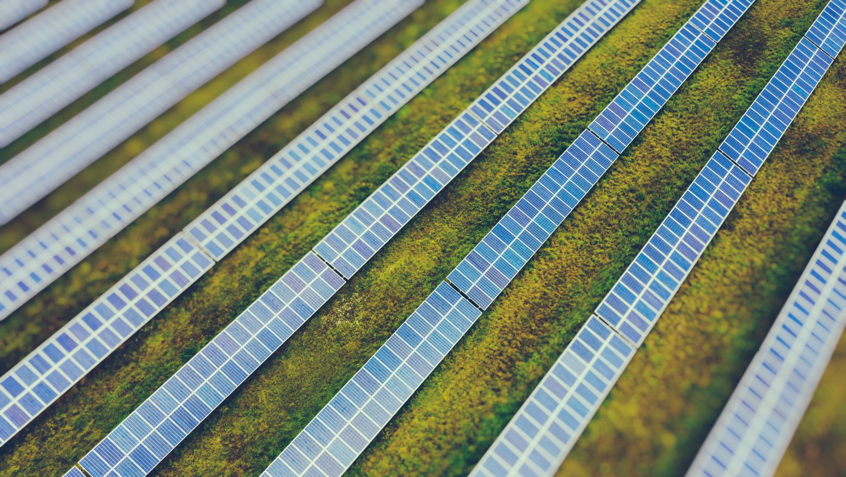
6 Tasks
Locating solar panels – Determining which buildings have solar panels, and where on site they are located.
Recording Location of Solar Panels – Writing down, using a photo, or using GIS to store data about where solar panel is located.
Installing and Updating Database – Getting solar panels installed, inputting the information into the database (client or contractor).
Giving Database Access to Dispatchers and First Responders.
PPE Recommendations – List of personal protective equipment needed to fight solar panel fires.
Dispatcher Training for Database – Dispatchers will watch videos and do hands-on training to understand how to use database to assist first responders.

Slide 5
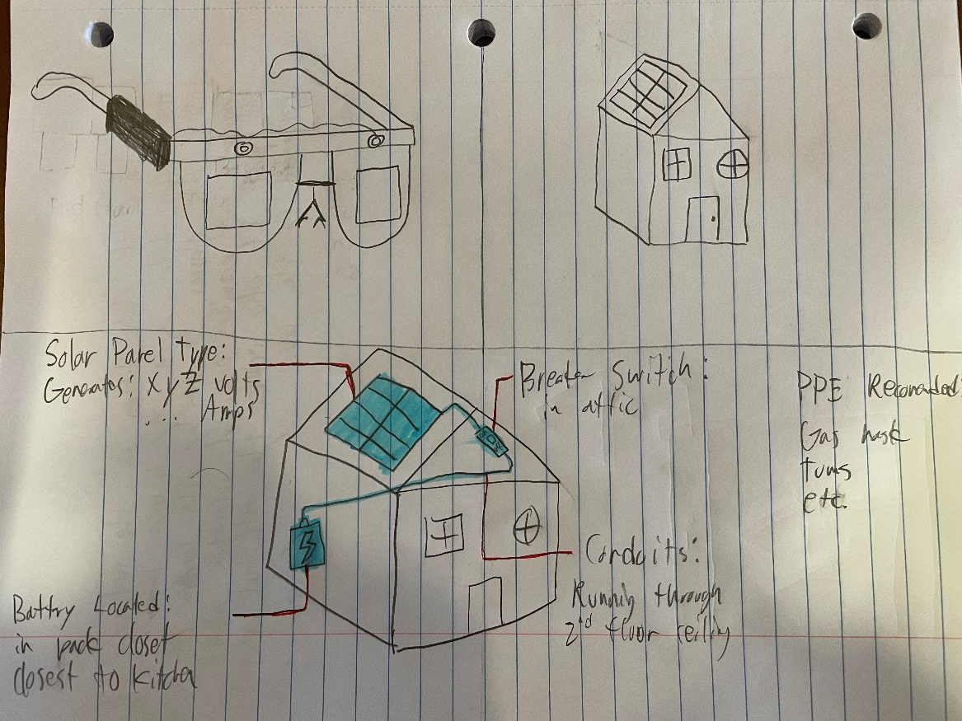
Design Sketch 1
The user wears the AR glasses to view the home.
The AR glasses give information about the home,
showing the solar panel model, breaker switch, and
lithium battery location.
With this, the user can create a plan to navigate
through the house.
Tasks: 1, 4, 5, 6

Slide 6
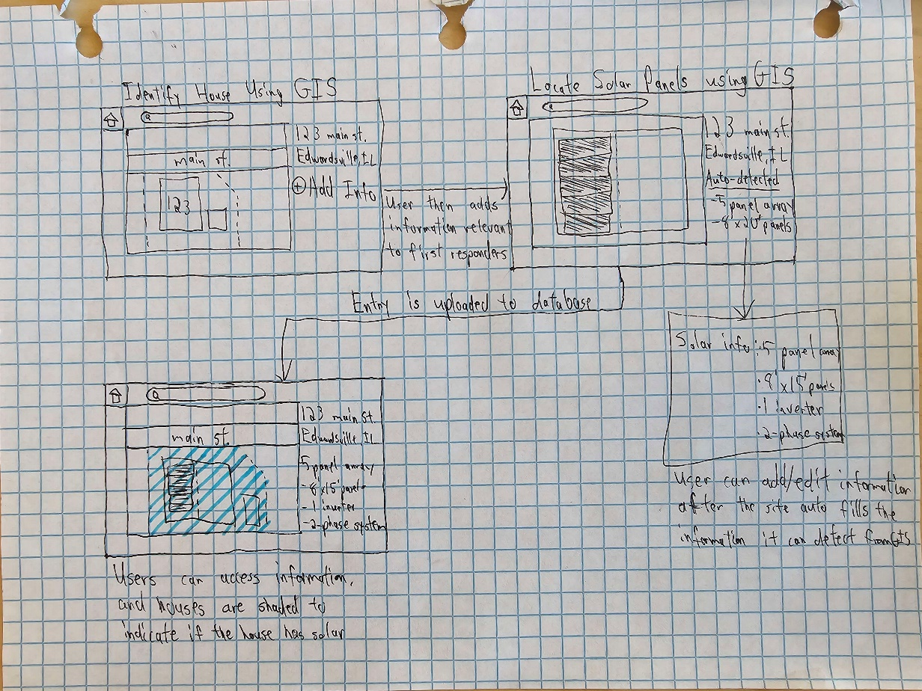
Design Sketch 2
The user locates the house on a satellite map.
Then they click the create new listing button.
Third, the user must edit the information
then submit it to the database.
Lastly, the user can now access the listing by
clicking on shaded houses or searching addresses.
Tasks: 1, 2, 3, 4

Slide 7
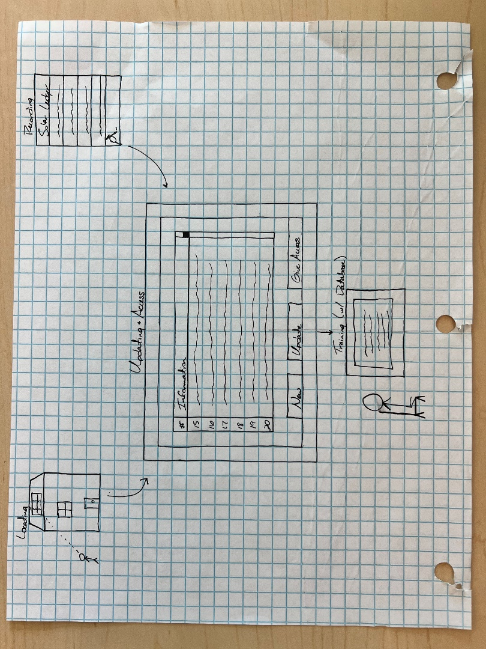
Design Sketch 3
First the individual locates the solar panel.
Next, the individual records the data of the solar
panel to their ledger.
Third, the individual then places this information
into the database and gives access to dispatchers.
Finally, the dispatchers sit through training to
understand and use the database correctly.
Tasks: 1, 2, 4, 6

Slide 8

Selected Design Storyboards and Tasks
The main reason we selected these tasks is because they are integral to the whole of our design. In order to release the information to first responders/dispatchers there needs to be a database filled. Likewise, we are unable to fill the database without multiple ways of recording and locating solar panels. We must empathize that these tasks are the fundamentals of our design and without being implemented well could jeopardize the deployment of the database.

Slide 9
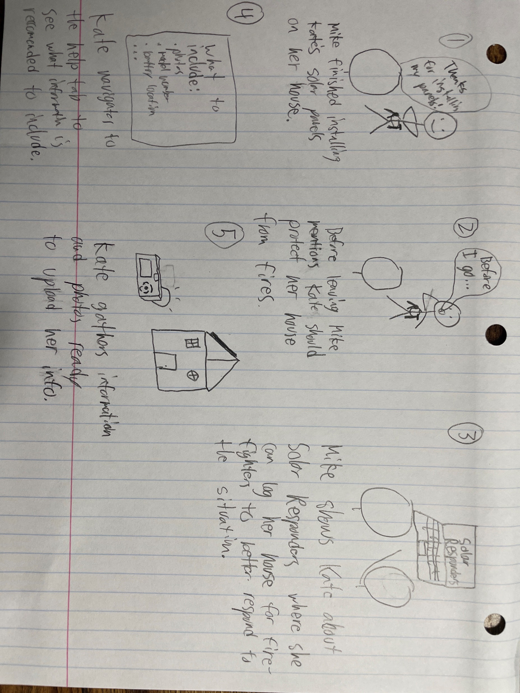
Storyboard 1

Slide 10
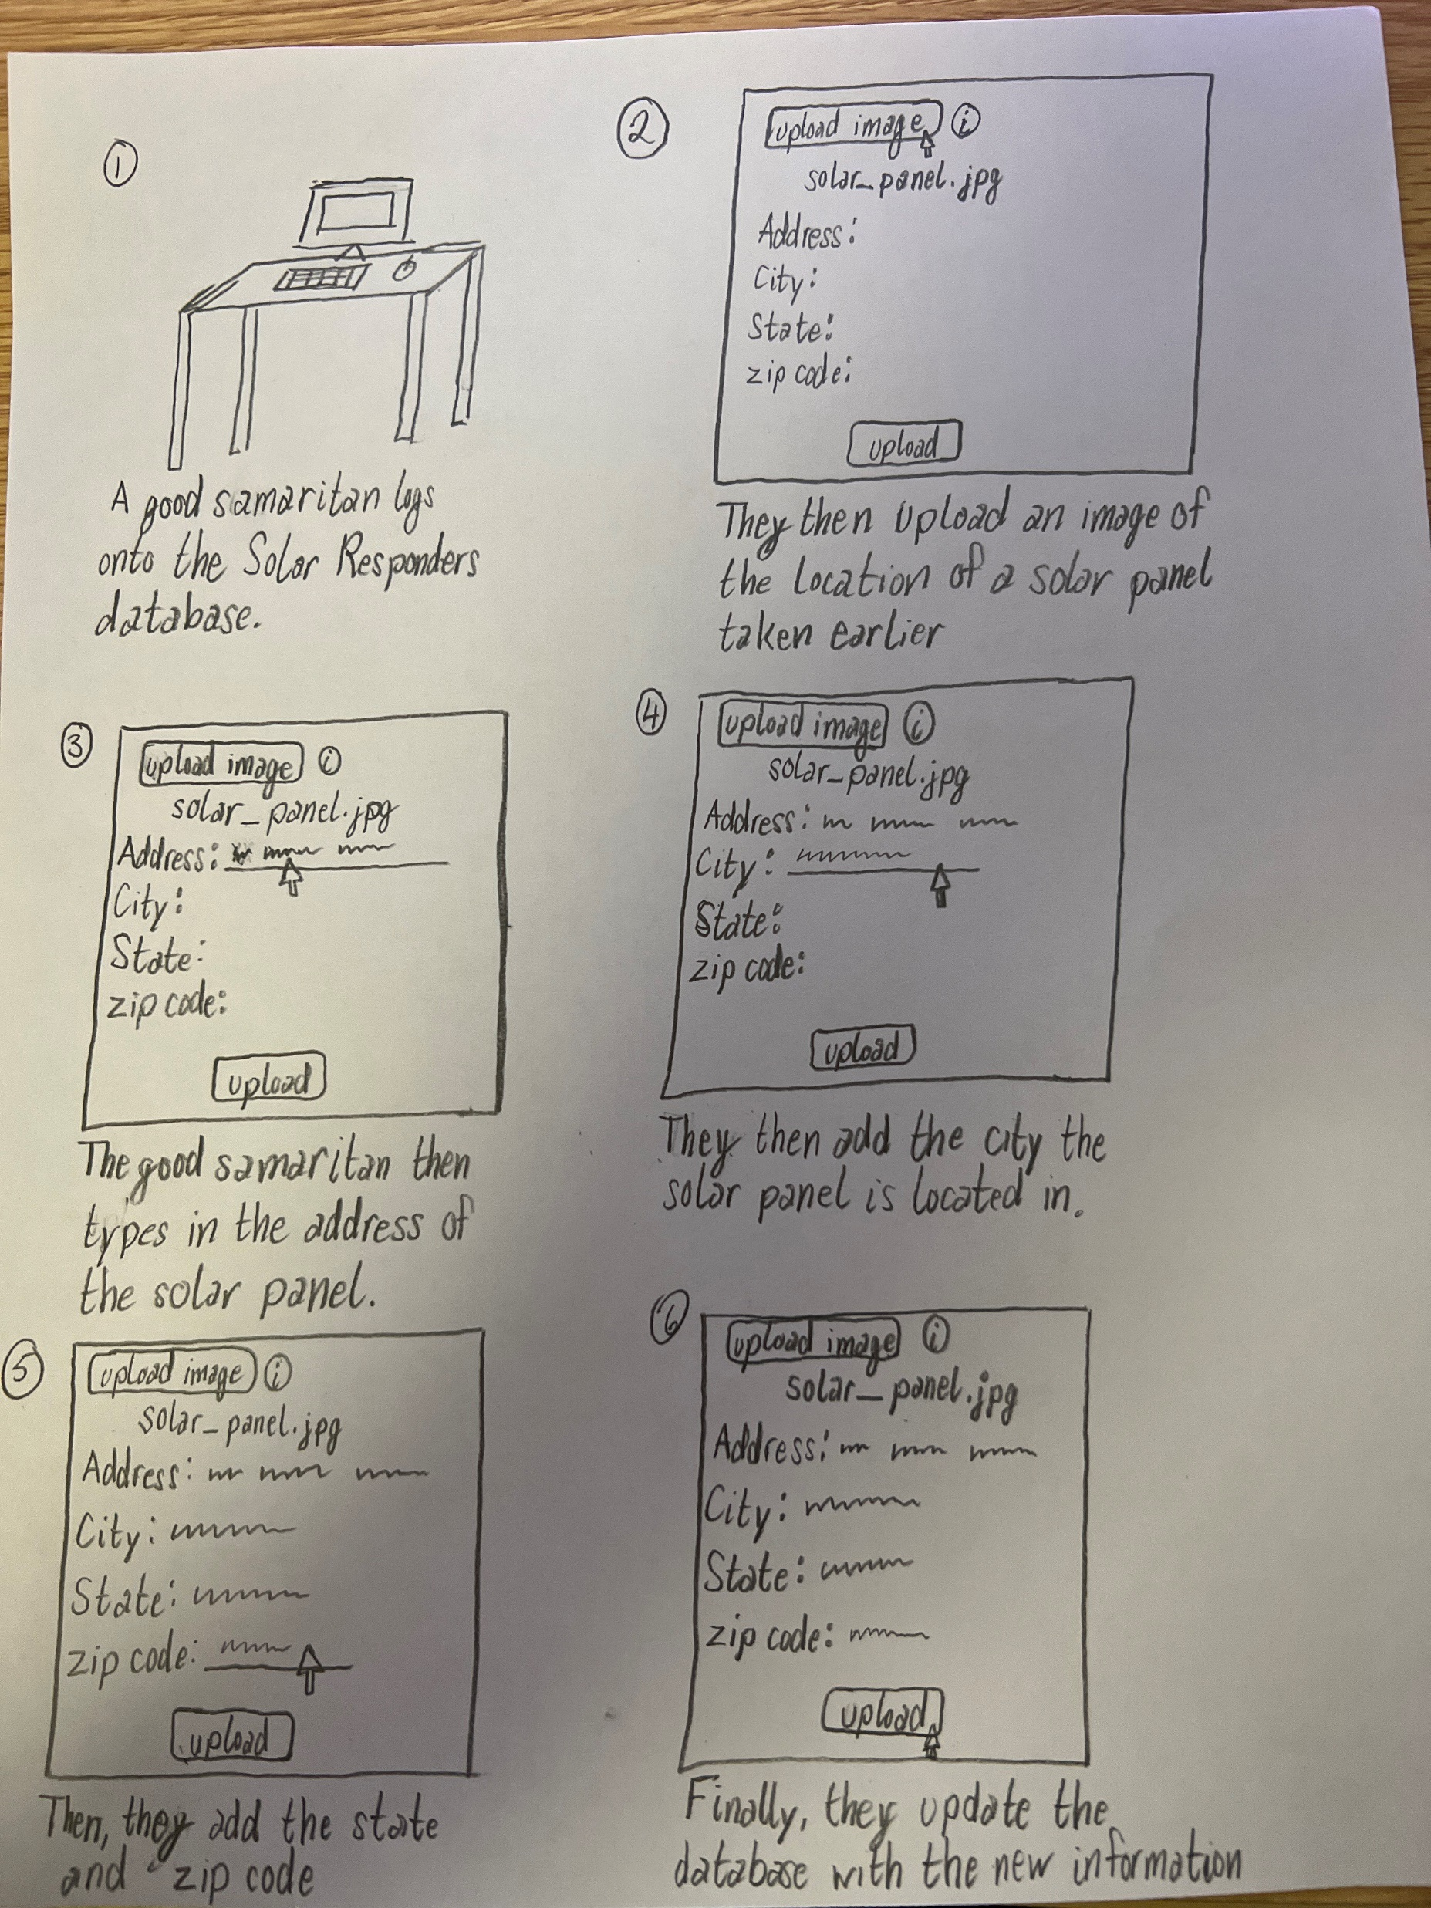
Storyboard 2

